Slide 1
BINARY TREES

Slide 2
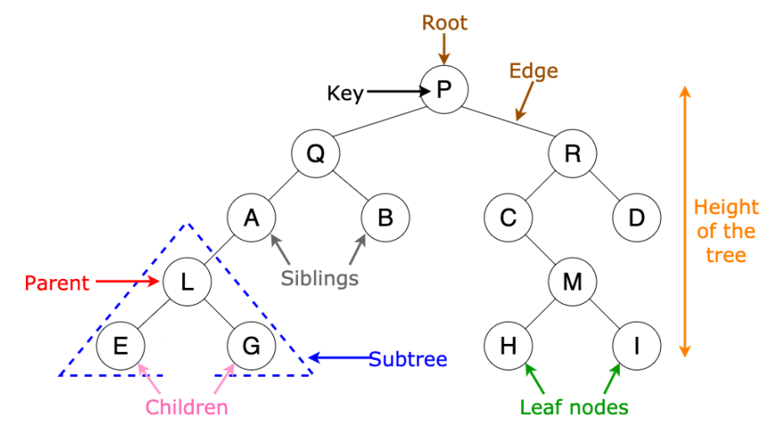
Binary Trees
A binary tree is a hierarchical data structure in which each node has at most two children.

Slide 3
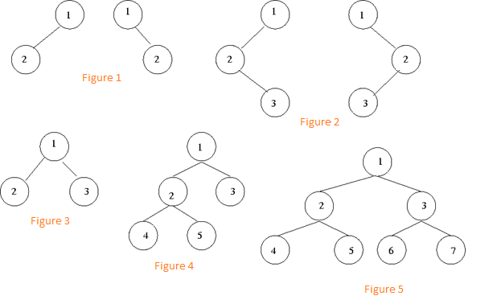
Examples of Binary Trees

Slide 4
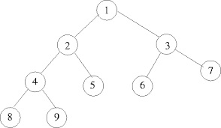
Properties of Binary Trees
Number of internal nodes = (Leaf node-1)
In this figure: Leaf node =5
So, Internal node = (Leaf node -1)
= (5-1)
= 4

Slide 5
Total number of nodes = (2 * Internal node)+1
Example: If the leaf node is 5 then how many nodes exist in the tree ?
Leaf node = 5
Internal nodes = (Leaf node-1)
= 4
So , Total number of nodes = (2*Internal nodes)+1
= (2*4)+1
= 9
Hence,
Total number of nodes =9

Slide 6
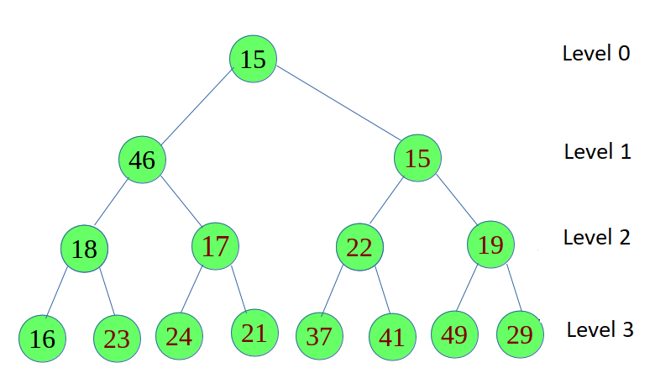

Maximum number of nodes at any level ‘L’ = $2^{L}$
At Level 0 , Nodes = $2^{0}$
At Level 1, Nodes = $2^{1}$
At Level 2, Nodes = $2^{2}$
At Level 3, Nodes = $2^{3}$
At Level L, Nodes = $2^{L}$

Slide 7
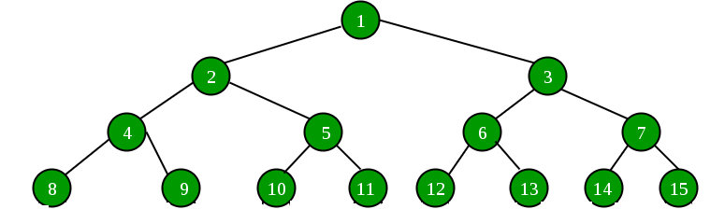

Maximum number of nodes = $2^{H+1}−1$
where H is the height of the tree
Example: If height of the tree is three then find the maximum number of nodes.
Height, H=3
Maximum number of nodes = $2^{H+1}−1$
= $2^{3+1}−1$
=15

Slide 8
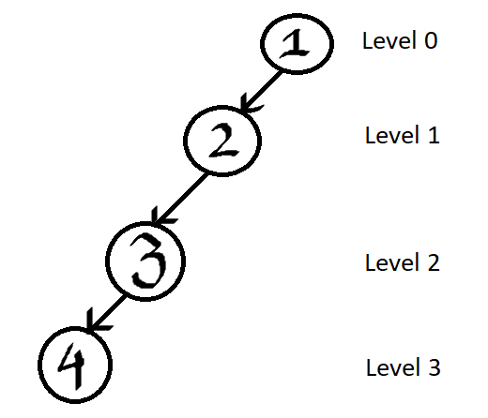
Minimum number of nodes = H+1
Example: If height of the tree is three then find the minimum number of nodes.
Height, H =3
Minimum number of nodes = H+1
= 3+1
= 4

Slide 9
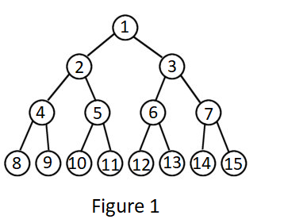
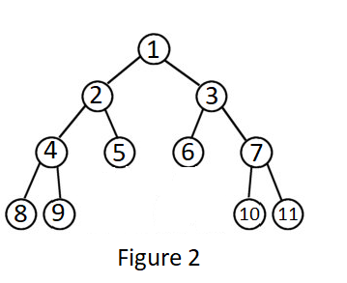
Full Binary Tree
A binary tree is a full binary tree if every node has zero or two children.

Slide 10
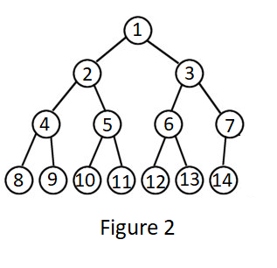
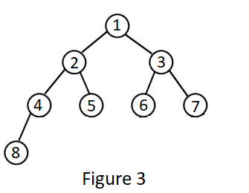
Complete Binary Tree
A binary tree is a complete binary tree if all the levels are completely filled except possibly the last level.

Slide 11
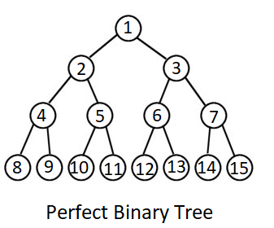
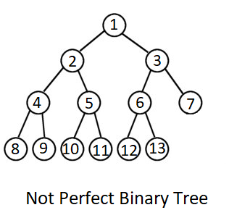
Perfect Binary Tree
A binary tree is a perfect binary tree in which all the internal nodes have two children and all leaf nodes are at same level.

Slide 12
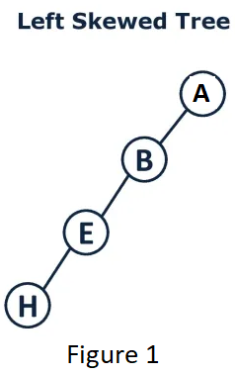
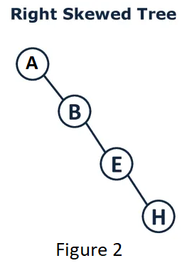
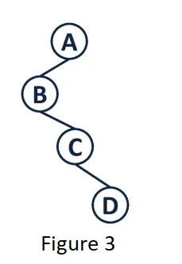
Degenerate Binary Tree
A binary tree is a degenerate binary tree where for each parent node, there is only one associated child node.

